Slide 1

Bangladesh University of Business and Technology
A Presentation on
Nobanno – A Movie Streaming Platform

Slide 2






Team : Diagon-Alley
Team Members
Md. Rashadul Islam
Md. Faysal Mahmud
Sadia sultana
Dipa Rani
Sadia Islam
Id: 19202103169
Id: 19202103174
Id: 19202103184
Id: 19202103201
Id: 19202103387

Slide 3
Index
Project Management Life Cycle
WBS (Work Breakdown Structure)
Gantt Chart
Project Budgeting
Our Approach

Slide 4

Chapter - 01
Project Management Life Cycle

Slide 5
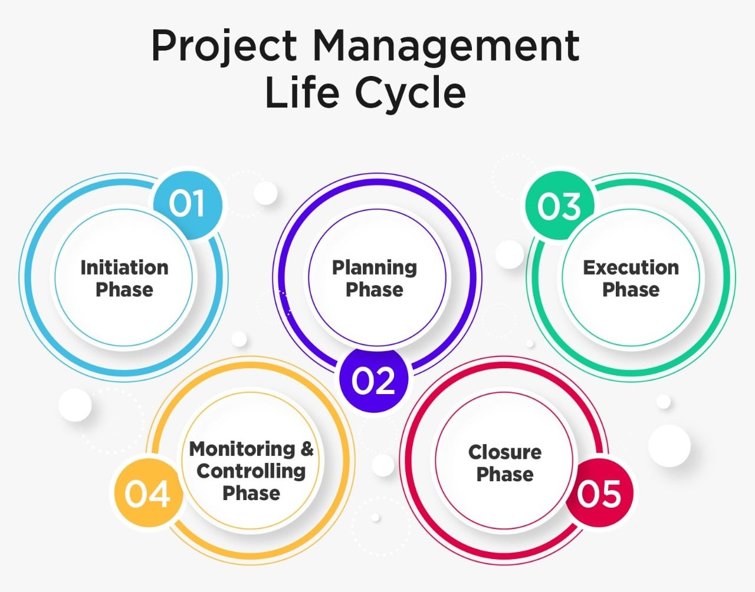
Initiation Phase –
- Understanding Project goals, deadlines and associate risks
Planning Phase –
- Project Planning, dividing work to the team, Risk management plan and so on.
Execution Phase –
- Executing project
Monitoring & Controlling Phase –
- Monitoring Project progress, performance, keep providing updates.
Closure Phase –
- Analyzing and summarizing the result

Slide 6

Chapter - 02
WBS
(Work Breakdown Structure)

Slide 7


What is WBS (Work Breakdown Structure)?
A Work Breakdown Structure (WBS) is a visual representation of a project’s
scope, tasks, and outcomes of a project.
It divides the project into smaller ones for better planning, management,
and control.

Slide 8
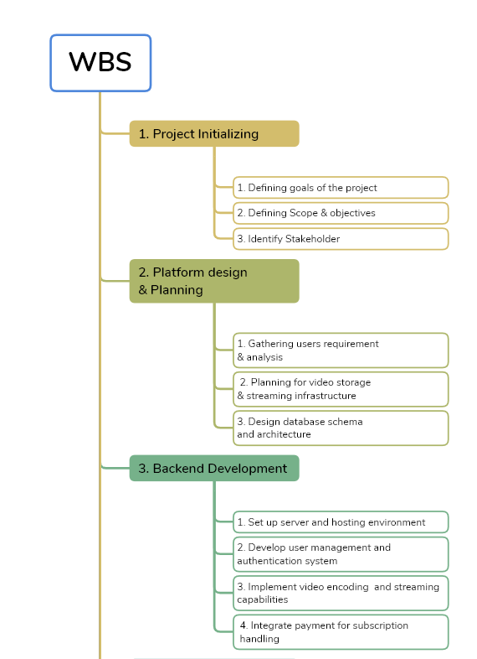
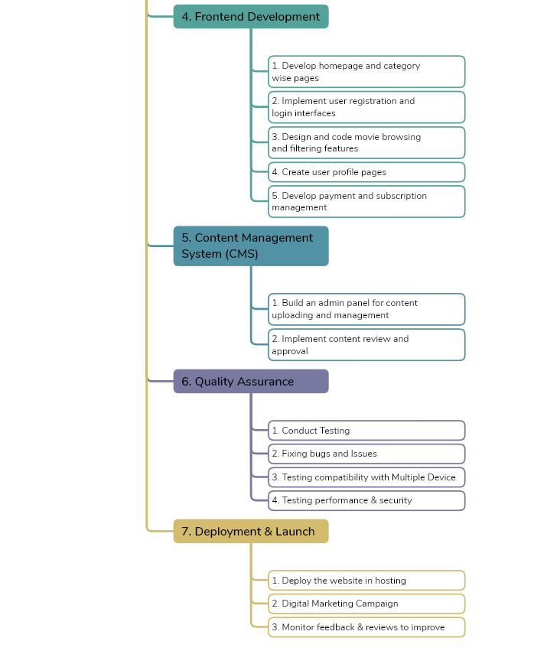
Work Breakdown Structure

Slide 9
Chapter - 03
Gantt Chart

Slide 10
What is Gantt Chart ?
A Gantt chart is a project management tool that allows project managers to
create a project schedule

Slide 11
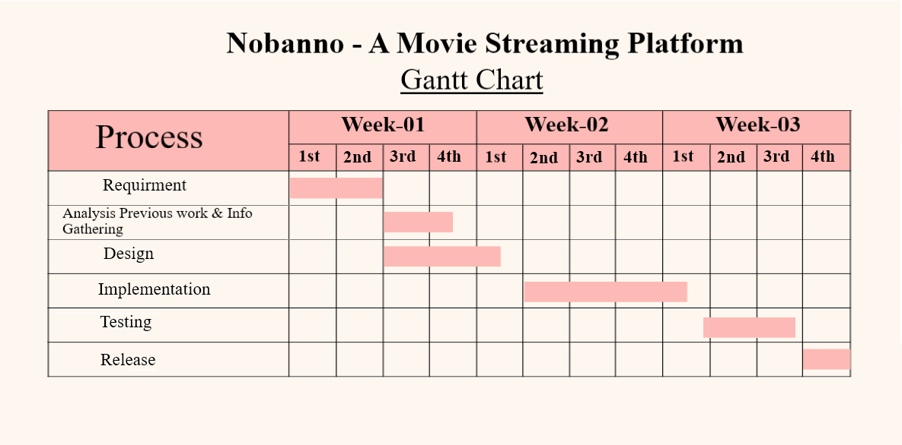

Slide 12
Chapter - 04
Project Budgeting

Slide 13
What is Project Budgeting?
A project's budget is the entire amount of money required to
complete the project that must be approved by all stakeholders.

Slide 14
Our Project Budgeting Estimation
Development Cost
Infrastructure and Hosting
Marketing and Promotion
Legal and Licensing
Other Overhead Costs

Slide 15
Chapter - 05
Our Approach
(Three – point estimation)

Slide 16
Reason ??
Realistic Cost Estimation: Considers best-case, worst-case, and most likely scenarios for
accurate average cost.
Risk Assessment: Identifies potential cost overruns and allows planning for contingencies.
Informed Decision Making: Helps stakeholders make well-informed budgeting decisions.
Accurate Budgeting: Ensures precise project planning and resource management
Wider Applicability: Suitable for diverse projects regardless of size or complexity.

Slide 17
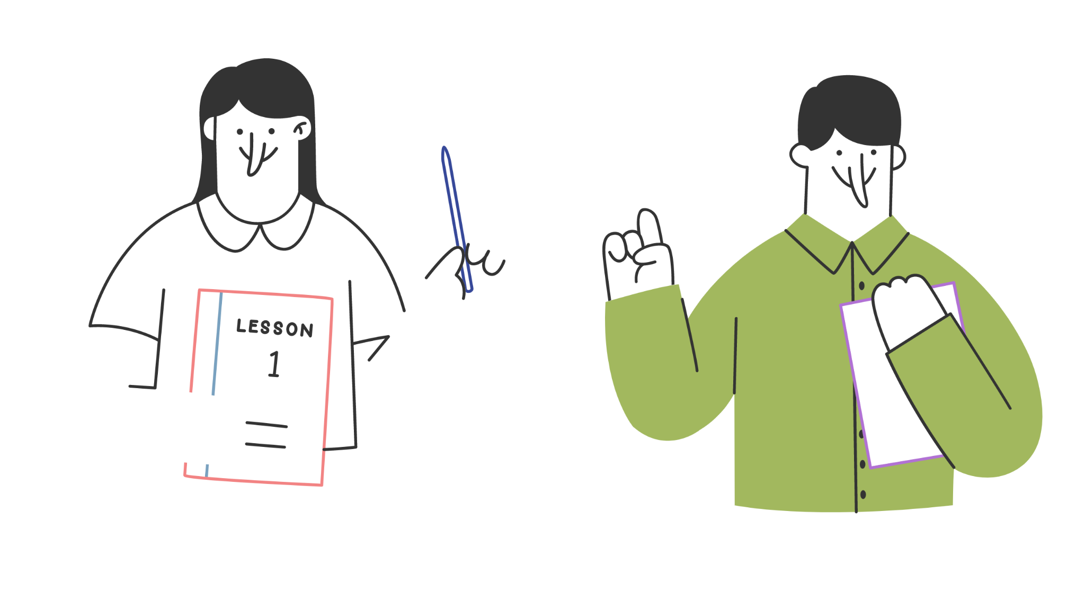
Thank you!

